Slide 1
Statistics for Linguists
2023-10-18
Adam J.R. Tallman

Slide 2
Course management
Moodle
Slides, homeworks, textbook, other optional readings, databases for exercises
Project
You are not graded for homeworks,
You must: write a project description in December
You must: write a draft of your paper
You must: write a final paper

Slide 3

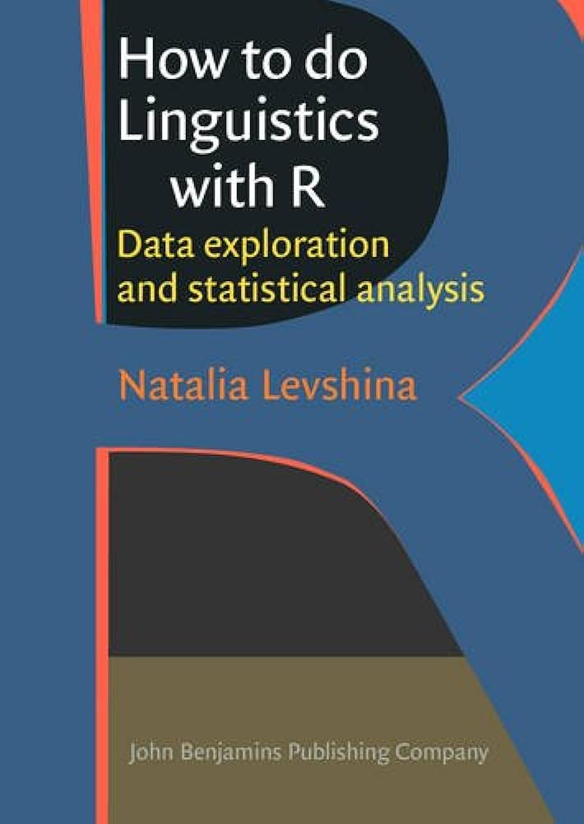
Textbooks

Slide 4
Starting
Download R
http://lib.stat.cmu.edu/R/CRAN/
Download R Studio
https://posit.co/download/rstudio-desktop/

Slide 5
What this course does
Using R
Descriptive statistics
Aggregating and summarizing data (e.g. sums, means etc.)
Inferential statistics
Making inferences about the validity of a hypothesis from data
Exploratory data analysis
Figuring out what is going on with data, with plots and machine learning etc.

Slide 6
Some terms you may have heard
P-values
Counterintuitive and often misinterpreted
Used in ‘null hypothesis testing’
Becoming controversial for actual stati
Linear models (“Regression”)
When you have to continuous variables and they change together
Multivariate linear model
When you have more tan two quantitative variables that change together

Slide 7
Other concepts
Binominal / logistic models
Predicting one of two outcomes from continuous data
Interactions
Where the strength and type of relationship between two variables depends on another variable
Multilevel models
Looking at relationships between lots of groups at once allowing different aspects of the model to vary depending on the group

Slide 8
Bad practices
data dredging:
grouping the data in different ways until it looks convincing
p-hacking:
doing statistical tests on data in different ways until a desirable p-value (e.g. below 0.05)
causal salad:
throwing in lots of variables without a theory and consideration of causal structure

Slide 9
‘Best’ (or better) practices
Practice preregistration instead of data dredging
Say what you think the hypothesis is going to be in some report prior to publication and make a distinction between confirmatory and exploratory analysis
Causal inference instead of causal salad
Use statistical models to test specific causal relations

